Slide 1


Slide 2

https://webpages.uidaho.edu/drbc/cs383/index.html

Slide 3
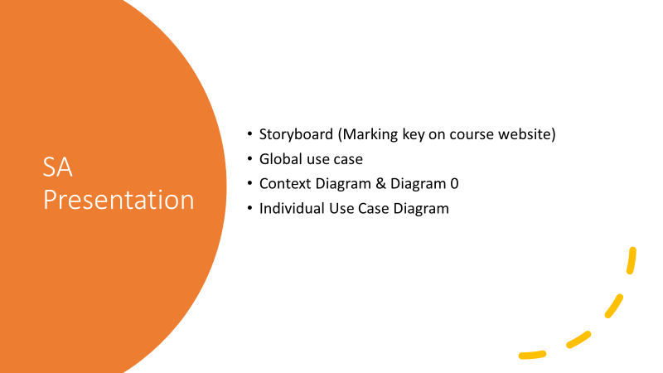

Slide 4
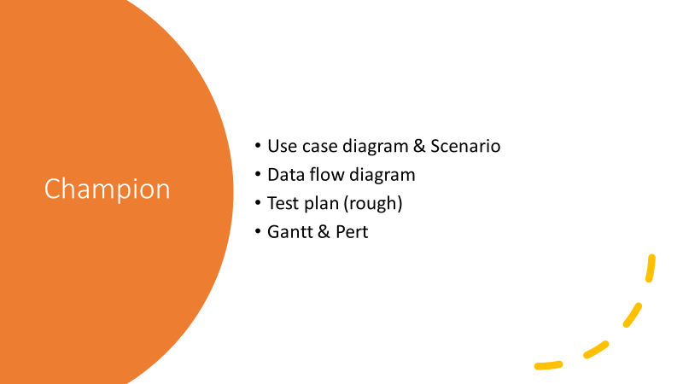

Slide 5
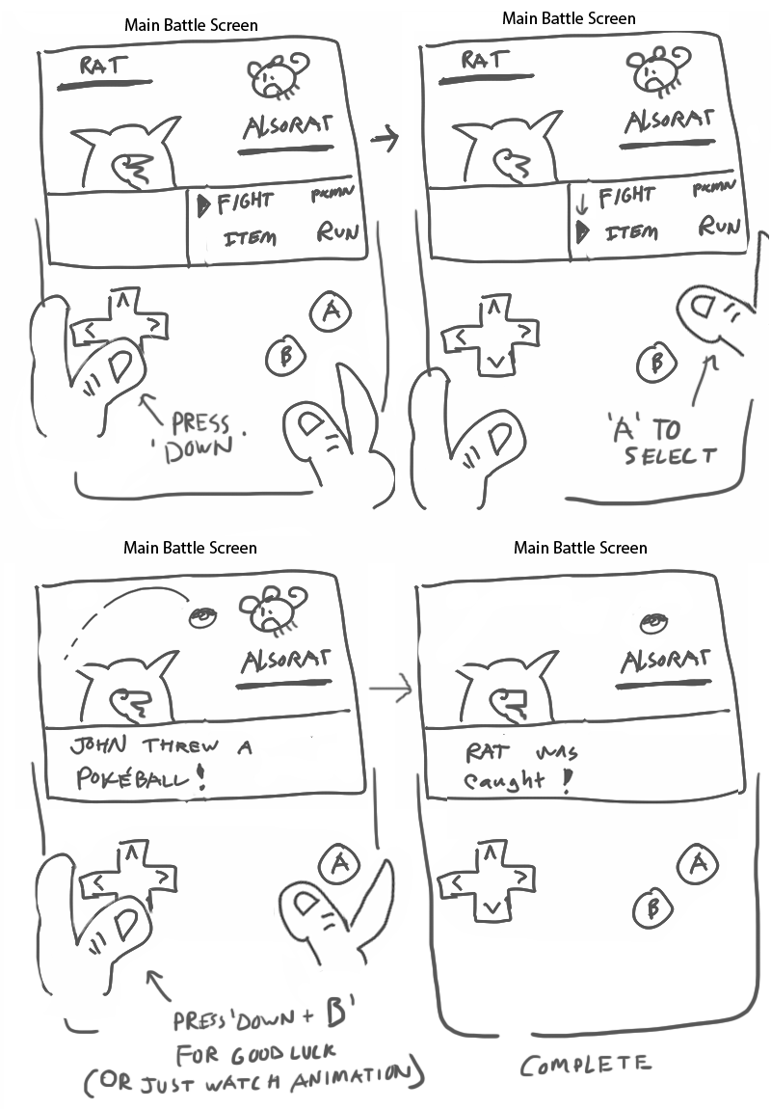
Storyboard 101
A storyboard is a way of visualizing our games before we make them. Placing the visuals and actions before we implement the idea. That way we can show them to others and receive feedback. It’s very close to movie storyboards where the writers draw the story and bounce ideas around before committing to making them.

Slide 6
What does a storyboard need?
The storyboards need to say who is in this scene ie: player, enemies, npc’s and how they’re moving. Or objects if you have a spikey wall that moves.
Describe if the characters are interacting in anyway. Like if they talk to each other or they fight each other.
Indicate how much time has passed between frames.
Describe how the camera interacts with the scene if its moving or mobile, if its zoomed in or out, things like that.

Slide 7
What we’ll need for this class
In this class were going to make something in between a storyboard and a beat board.
You might be asking what is a beat board? Well it's just a simpler storyboard.
A beat board is displayed in 9-16 images and with not as much detail excluding stuff like camera and dialogue.
This allows us to show these things in a more general and simpler way to present out pitch faster.
Just think of it as you telling a story of how your game is going to go.

Slide 8
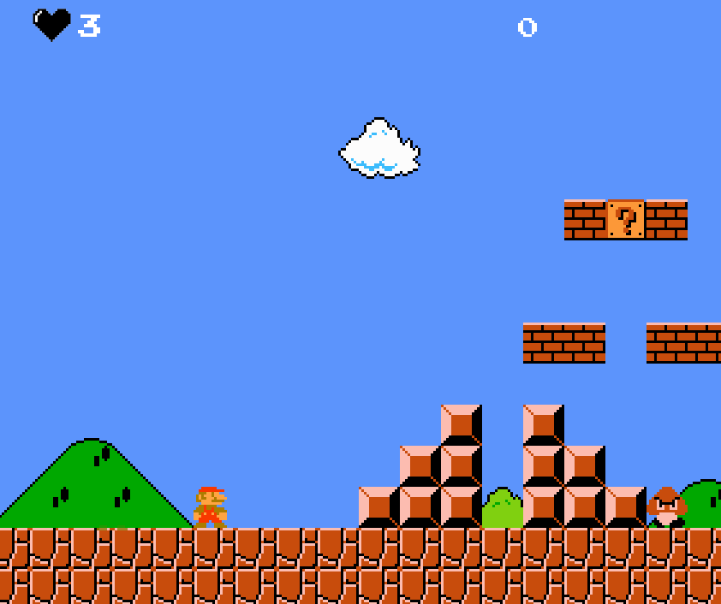
First scene
Dialogue: Mario is trying to get to the other side of the map. Along the way he will encounter obstacles to his journey to the castle.
Characters: Mario is here and must travel to the right to further his journey. Along the way there is a goomba, an enemy that he has to avoid or squish.
Objective: There is also a mystery block he can hit to get a power up!

Slide 9
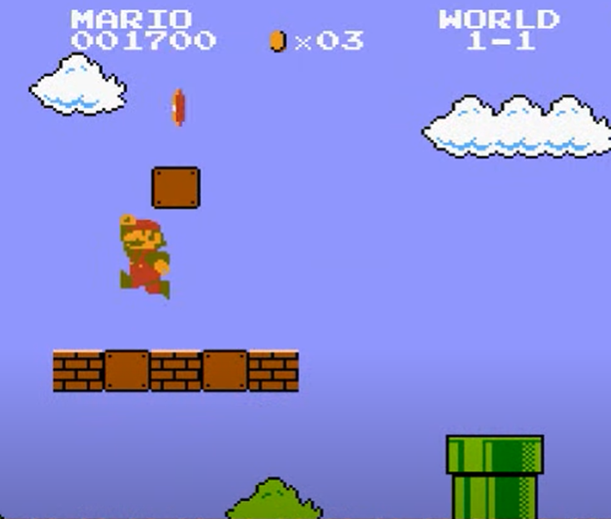
Second scene
Dialogue: This is later in the game after that first scene. Mario here can collect a coin as he’s collected two before. Now he’ll keep pushing forward to his destination.

Slide 10
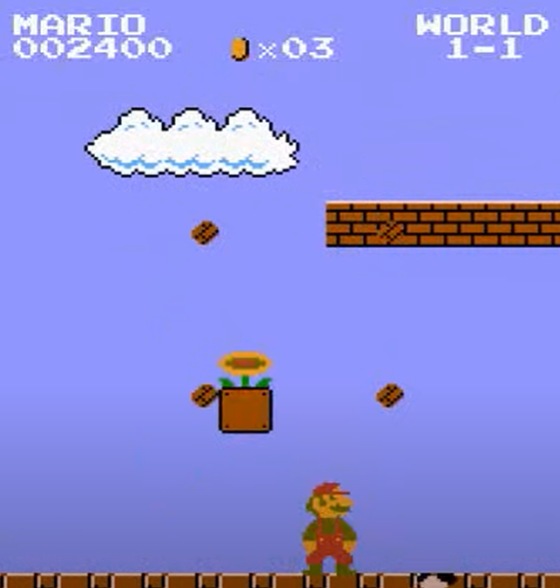
Third Scene
Dialogue: Mario continuing on his journey finds a fire plant that allows him to gain fire powers. This’ll help him with any enemies he may find in the future.

Slide 11
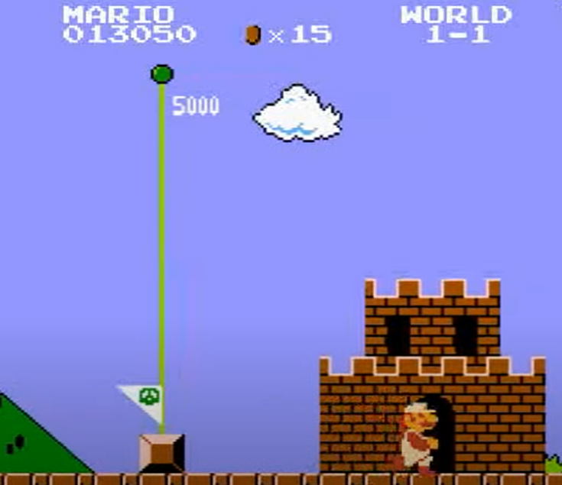
Fourth Scene
Dialogue: Mario finally makes it to his destination and walks into the castle. Where he can chill and relax from his crazy adventure.

Slide 12
TL1 Presentation
Git, Version Control and GitHub
By: Mauricio,Palak and Shashwot

Slide 13

What is Git?
Git was made by Linus Torvalds in 2005(The same guy that made linux).
Originally made with the linux kernel in mind.
Git is an open source free program that encourages collaborative work
Git can be seen as a local piece of programming that allows the user to save previous versions of code.

Slide 14
Terms to know
Repository: These are things that hold your code and previous versions of it. Think of them like the folders in file explorer.
Local Repository: The repository you have on your computer.
Remote Repository: The repository found on github.
Remote Repository:
Main Branch: The main branch is where the most up to date code is. Think of this as the trunk of a tree.
Branch: A branch is an offshoot of the main branch where modifications can be made without affecting the original code. WE CANNOT MAKE THESE
Merge: This is where if we’ve made a branch we go back into the main branch. We “merge” with the main branch. This is the reason we cannot use branches because if our code does not merge correctly were in trouble.
Commit: A commit is a change done to the main branch that is then “saved”. I put saved in quotes because you can go back to a previous version of code through a previous commit. Think of it as a save point in a video game. Where if you want to go back and not do something you just load your previous save.
Push: A push is uploading a commit/change to a remote repository.
Pull: A pull does the opposite it takes the current version of the remote repository and places it in the local repository.
Later on we’ll learn how to perform these actions.

Slide 15

What is Github?
Github is the cloud version of git where repositories are online.
Github was released in 2008. It too is free and open source.
Used by many different businesses and developers who are working on collaborative work.

Slide 16
Github Desktop
Github desktop is similar to github but its on your local machine is more similar to the git command line except with a ui.
It allows for the same things as github does but on a local machine. You can upload things to the cloud if you desire by pushing it on.

Slide 17
Getting Started with GitHub

Slide 18
Ways that we can use Github in different OS
Windows
GitHub Desktop
Terminal (Command Prompt or Windows PowerShell)
MacOS
Github Desktop
Terminal (???)
Linux
Terminal

Slide 19
Download Git
Windows:
Git for Windows (Git Bash):
Go to the Git for Windows download page.
Download the installer that matches your system (32-bit or 64-bit).
Run the installer and follow the installation instructions.
During installation, you can choose options like enabling Git Bash (a Unix-like command line) and integrating Git into Windows Command Prompt.
GitHub Desktop:
If you prefer a graphical user interface (GUI), you can also use GitHub Desktop, which includes Git. Download it from the GitHub Desktop website.

Slide 20
Linux (Ubuntu as an example):
Using Package Manager (Apt):
Open a terminal.
Run the following commands: sudo apt update sudo apt install git

Slide 21
macOS:
Homebrew:
If you have Homebrew installed, open Terminal and run:
brew install git
Xcode Command Line Tools:
On macOS, Git may already be installed as part of the Xcode Command Line Tools. To check, open Terminal and run:
git --version (If Git is not installed, macOS will prompt you to install it)
Git Website:
You can also download Git for macOS directly from the Git website. Download the macOS installer and follow the installation instructions.

Slide 22
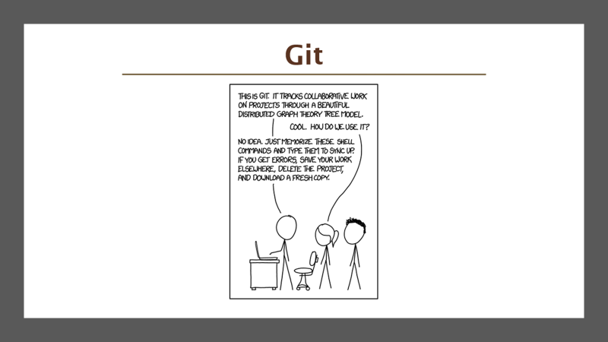

Slide 23
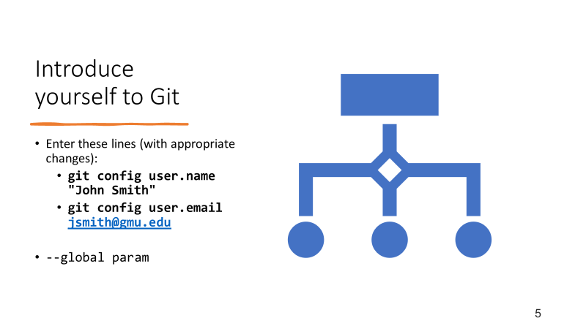

Slide 24
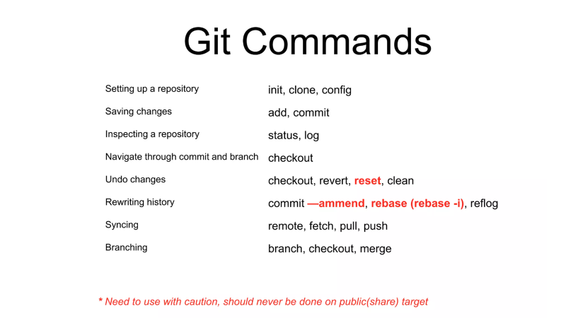

Slide 25
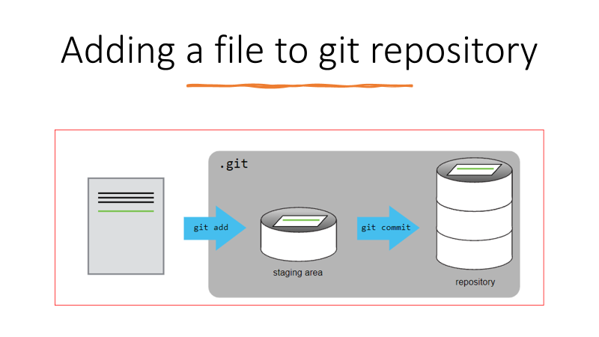

Slide 26
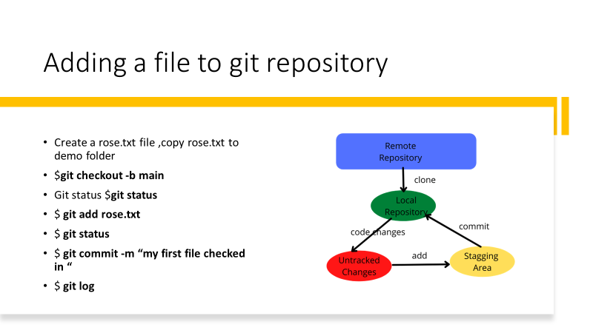

Slide 27
For terminal use:
Cloning a Repository
git clone <repository_url>

Slide 28
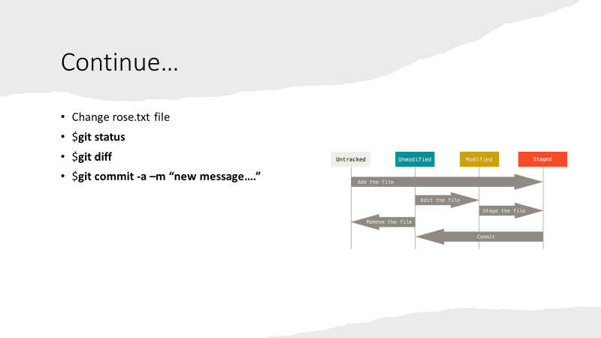

Slide 29
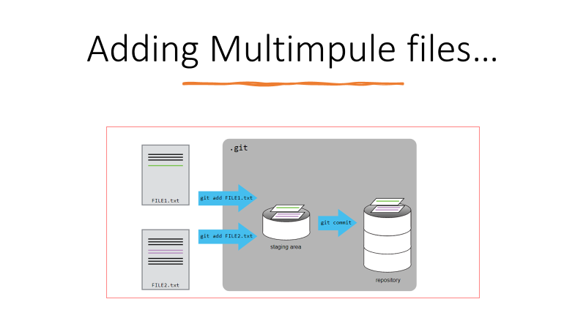

Slide 30
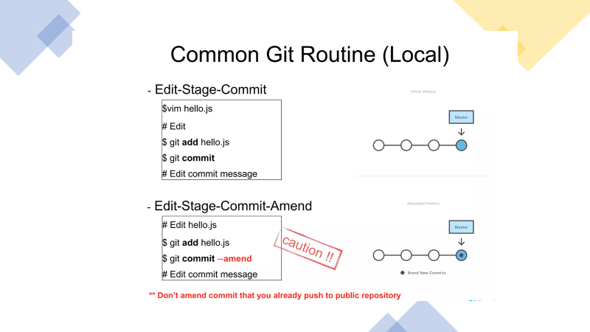

Slide 31
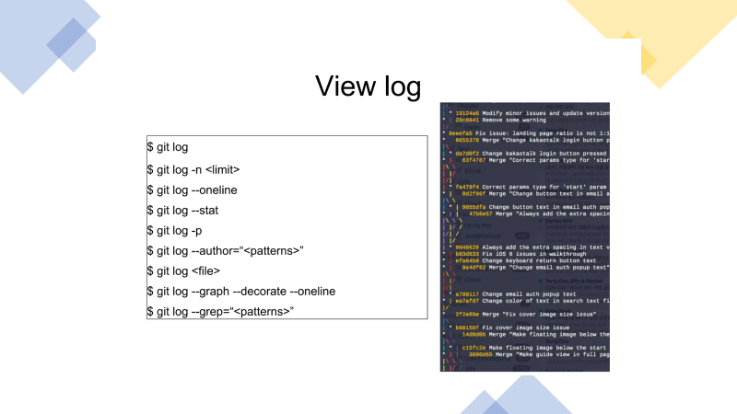

Slide 32
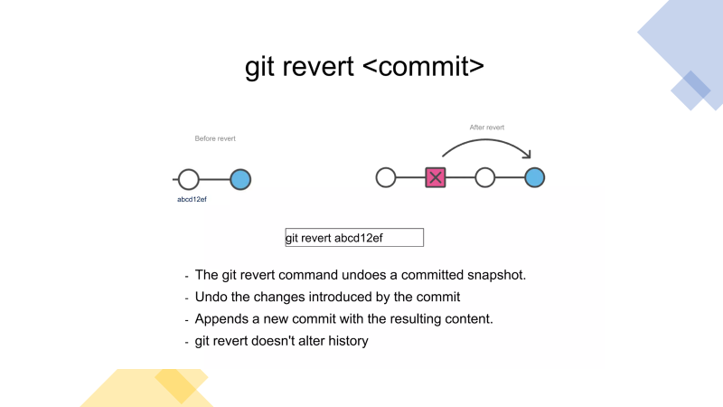

Slide 33
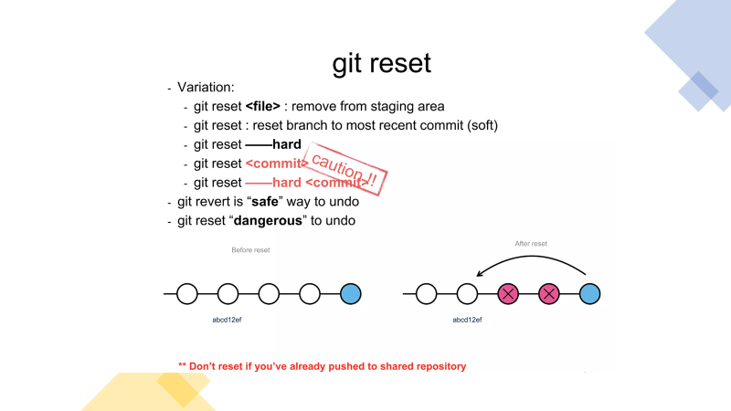

Slide 34
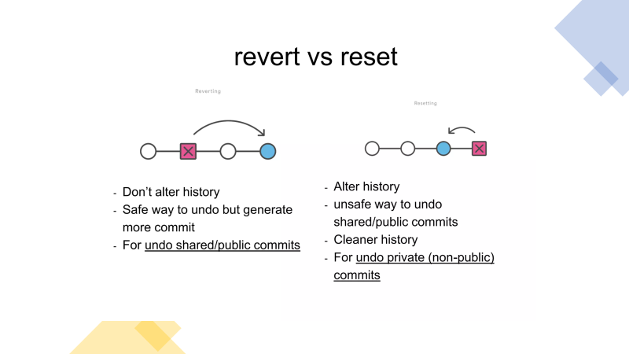

Slide 35
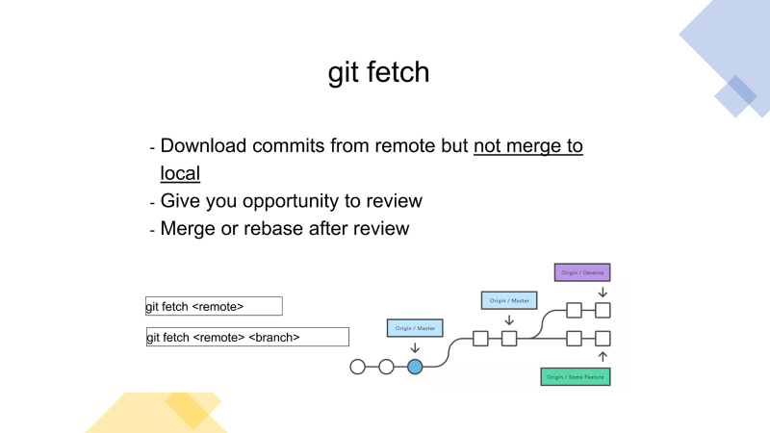

Slide 36
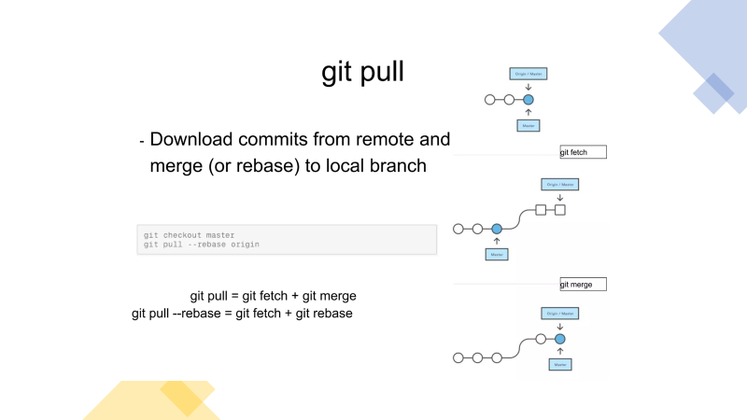

Slide 37
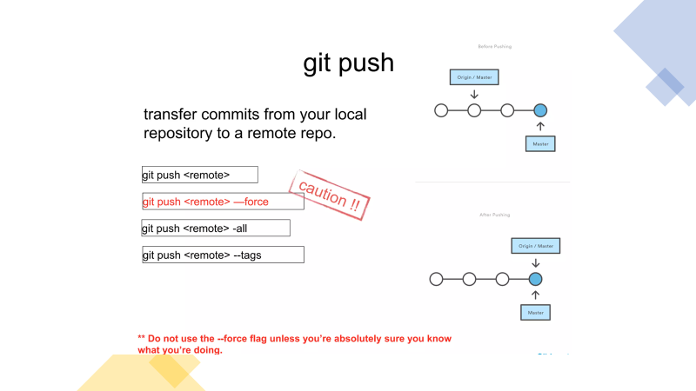

Slide 38
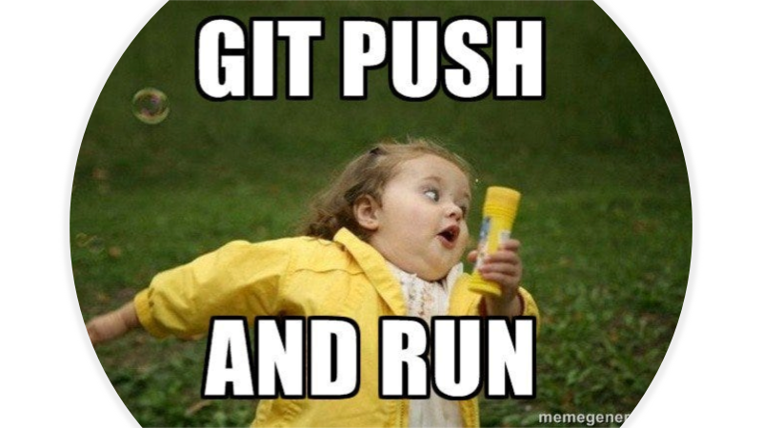

Slide 39
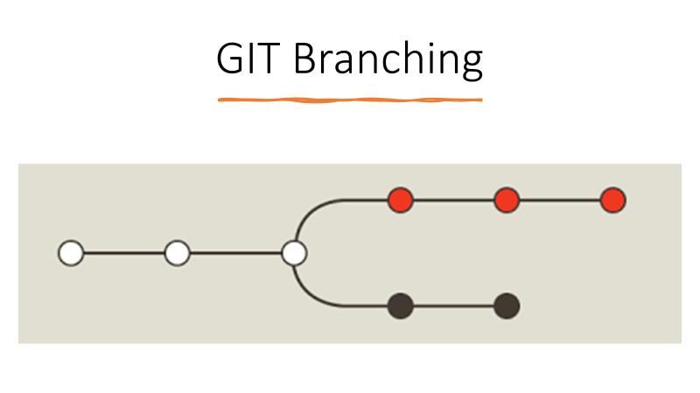

Slide 40
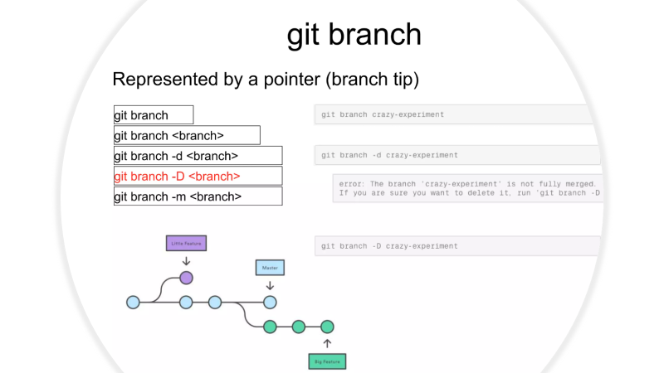

Slide 41
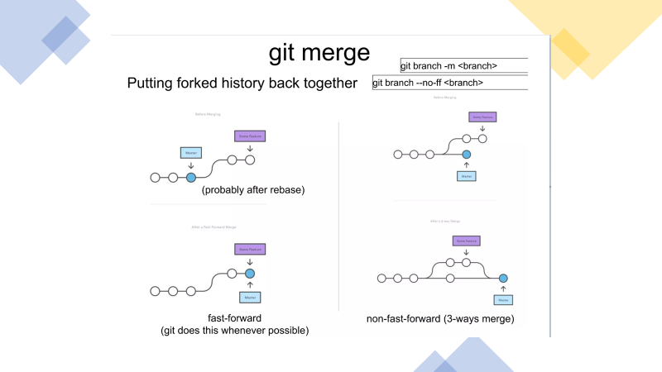

Slide 42
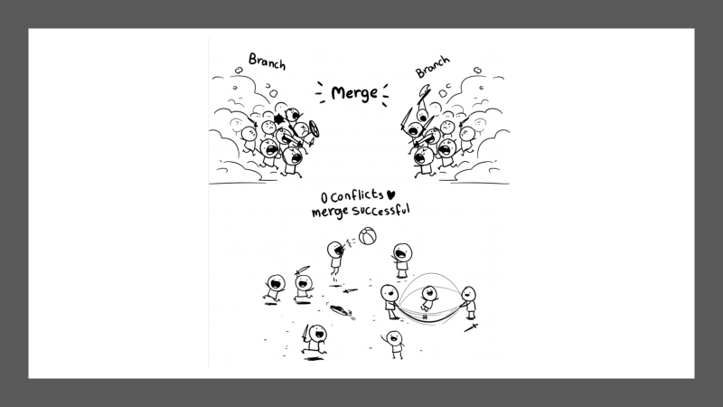

Slide 43
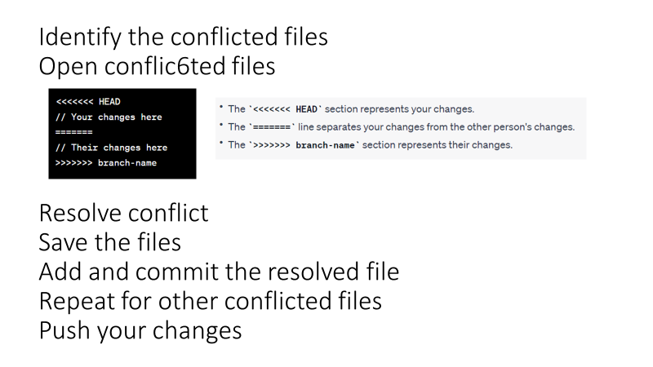

Slide 44
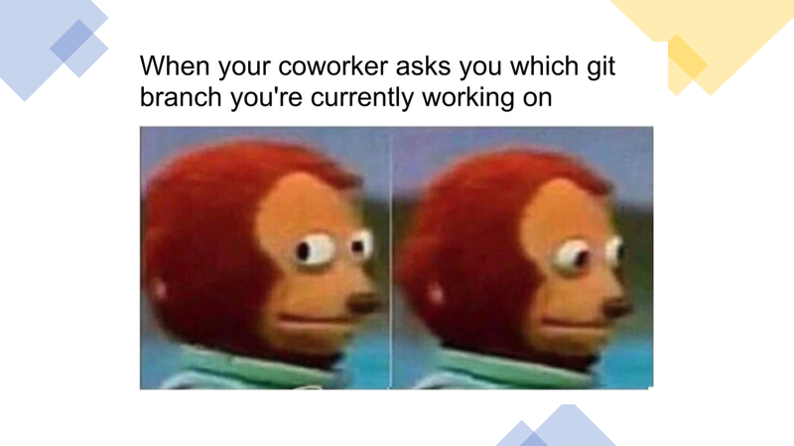

Slide 45
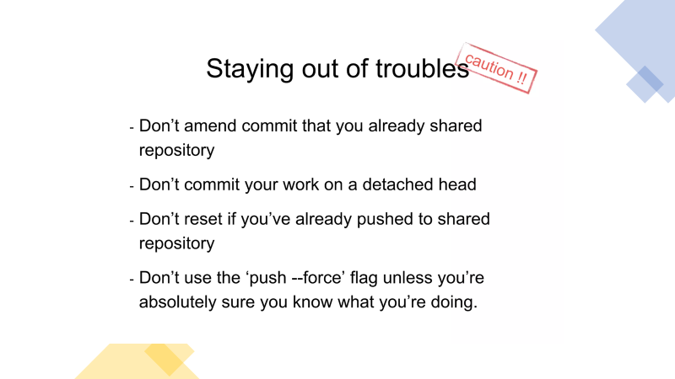

Slide 46
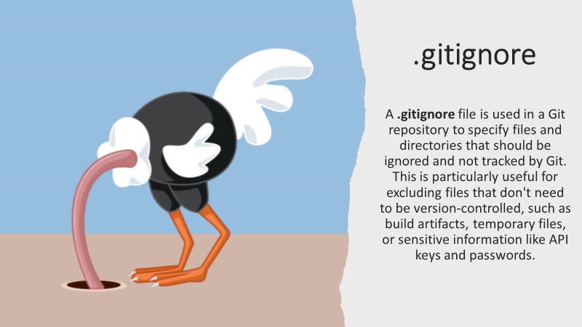

Slide 47
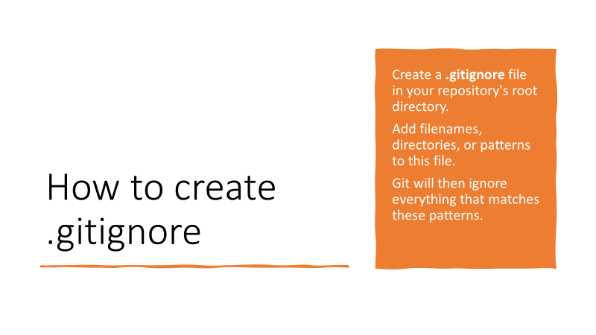

Slide 48
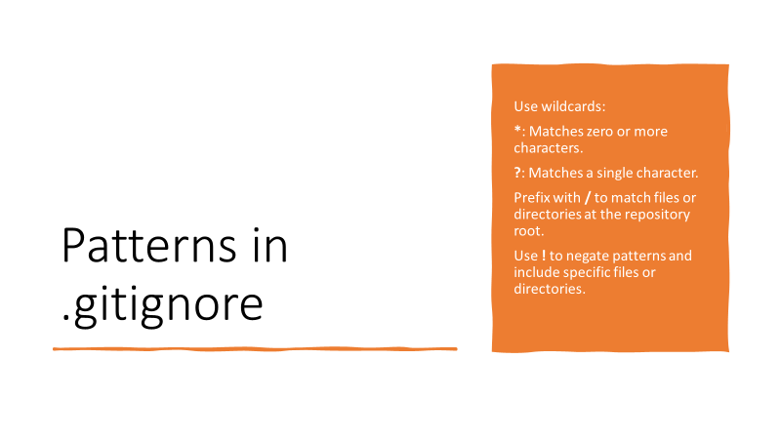

Slide 49
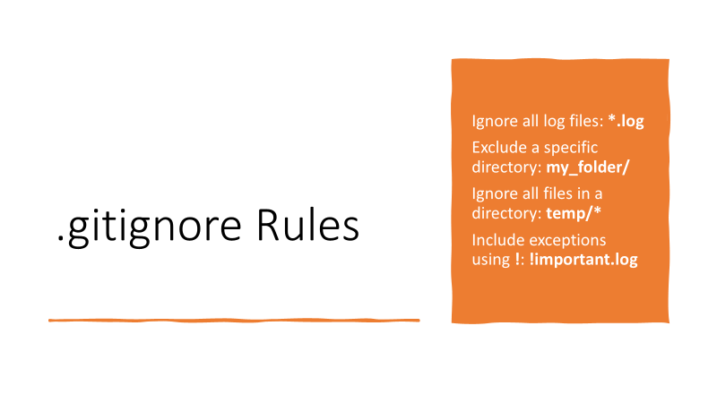

Slide 50
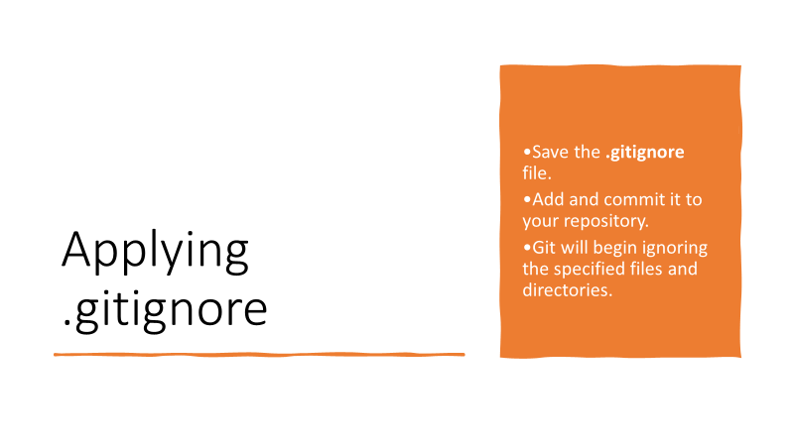

Slide 51
For Github Desktop User

Slide 52


